Slide 1
Government and Cloud
The current thinking on the technical architecture for the UK government’s proposed
G-Cloud and App Store
Kate Craig-Wood
CEO, Memset Dedicated Hosting
Technical Architecture Co-lead, G-Cloud Project

Slide 2

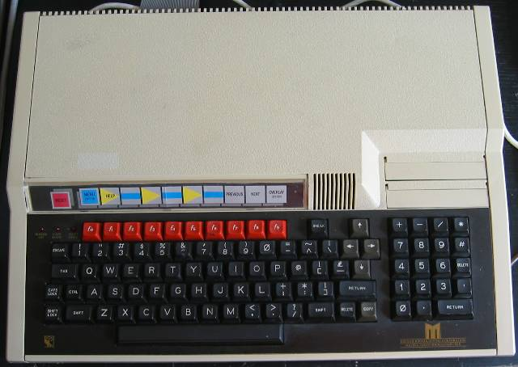






Who is Kate?

Slide 3
UK G-Cloud & App Store
In order to reduce cost & carbon without compromising service quality, UK public sector wants:
Like-for-like service comparability
Resources pooling from multiple providers
Workload pooling for peak load curtailment
Pay-as-you-use billing
Access to cost benefits of massively automated ICT services
Interoperability to avoid vendor lock-in
Likely answer: A government ICT services marketplace into a hybrid of several private community clouds.

Slide 4
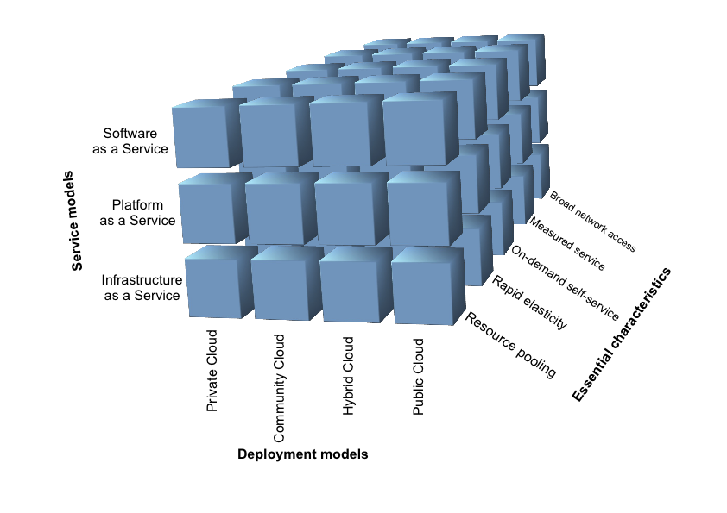
NIST’s Cloud, on a cube

Slide 5
G-Cloud view of the stack

Slide 6
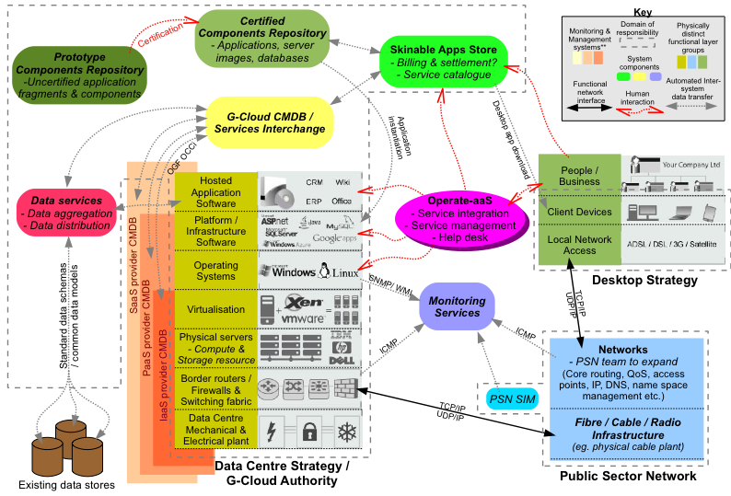
Possible G-Cloud architecture

Slide 7
G-Cloud maturity model

Slide 8
Cloud Computing and Information Assurance (Security)
“Cloud” often considered insecure, but why?
  In 8 years Memset have had zero VM break-outs.
  Can be more secure, eg. security through obscurity.
  Bigger concern is perhaps organisational threat.
Though network virtualisation is okay, GCHQ has not certified the hypervisor layer as a suitable barrier.
  Physical segregation still required for some services.

Slide 9
Some public cloud services will suitable for some pub. sec. needs
Private Cloud Services
Flexible
Public Cloud Services
SERVICE LEVEL AGREEMENT
Public Cloud services with enough location-specific assurance at SLA we’re able to accept
Fixed
Agnostic
DATA & SERVICE LOCATION
Specific

Slide 10
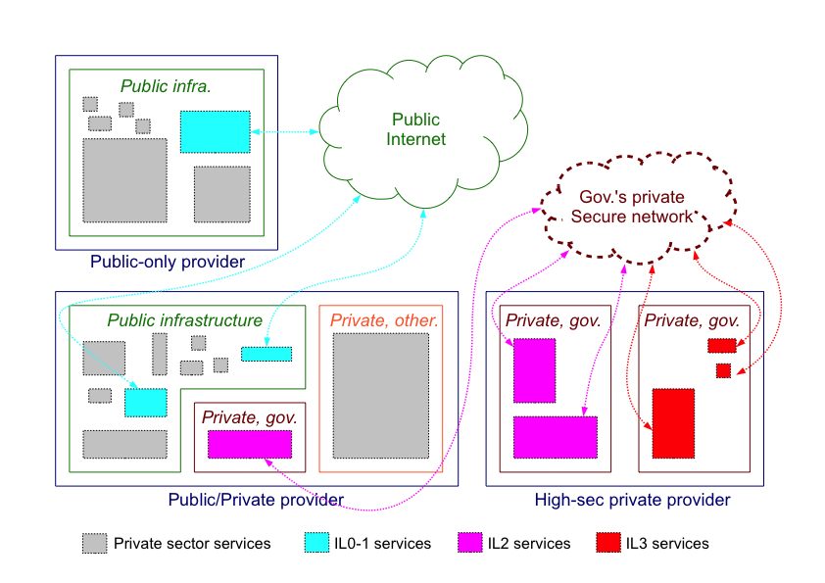
A cloud for each Impact Level (IL)

Slide 11
Security summary
Some public cloud suitable for IL0, perhaps IL1 & 2
Secure G-Cloud: Probably 1 private cloud per IL > 1
Additional complicating factors:
  3 IL aspects: Confidentiality / Integrity / Assurance
  IL-threat combinations
  Risk aggregation
All tractable problems, though!

Slide 12
Thanks!
kate@memset.com
@Memset_Kate
Blog: KatesComment.com

